Slide 1
Proof of flight patterns of multi-layered balloon
Min Hyeong Lee, Seoul National University

Slide 2
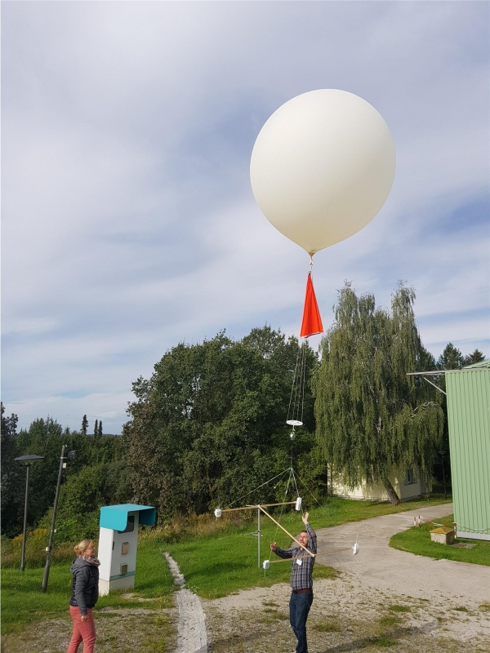
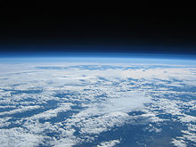
Near space balloon :
This is the balloon which is made of strong material as it can take its surface tension in very low pressure. It goes above stratosphere and bursts under approximately 30km.
Picture taken at 30 km using a 1,500 gram weather balloon

Slide 3
How can we make it go higher?

Slide 4
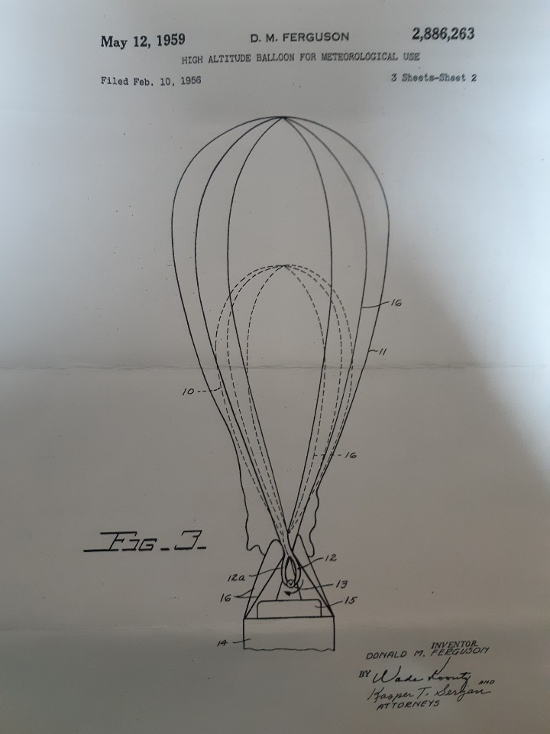
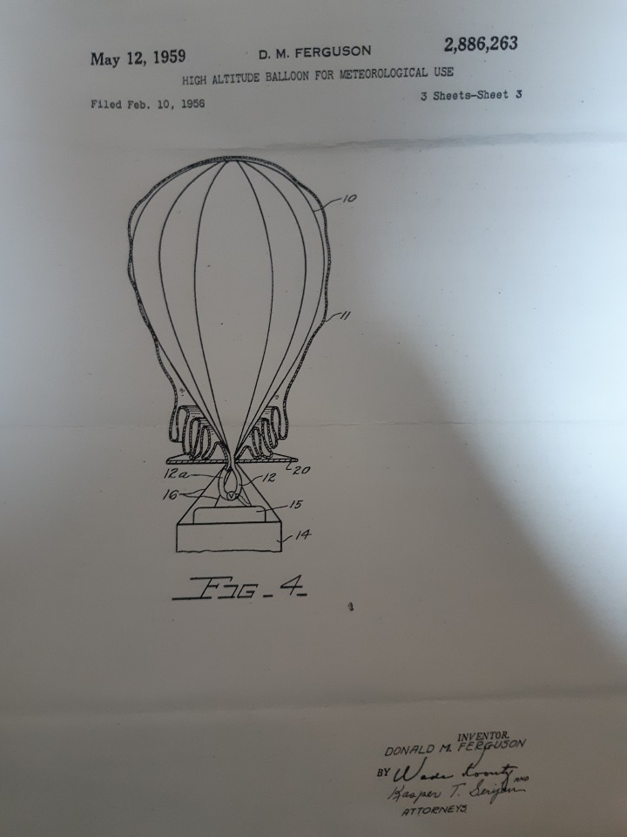
Concept of multi-layered balloon

Slide 5
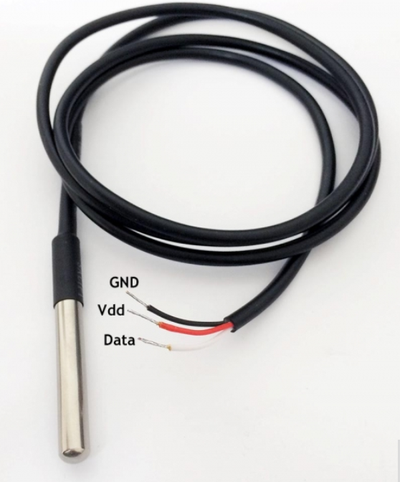



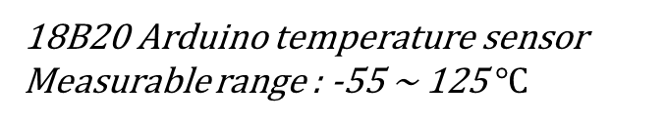
18B20 Arduino temperature sensor
Measurable range : -55 ~ 125 $℃$
MCU - Arduino
DM118 Arduino SD card module
Operating voltage: 3.3 ~ 5V
G-per , GPS with LoRa Network

Slide 6
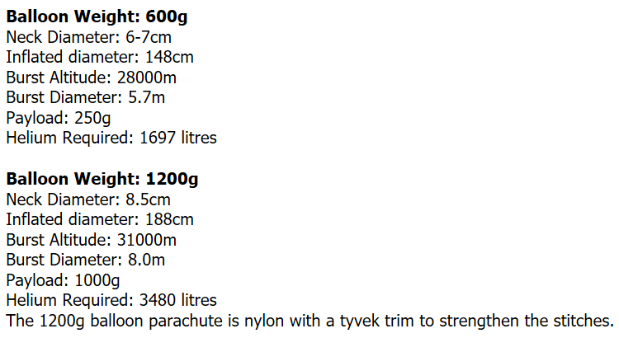
Expected performance of balloon (600g, 1200g) used in this study

Slide 7
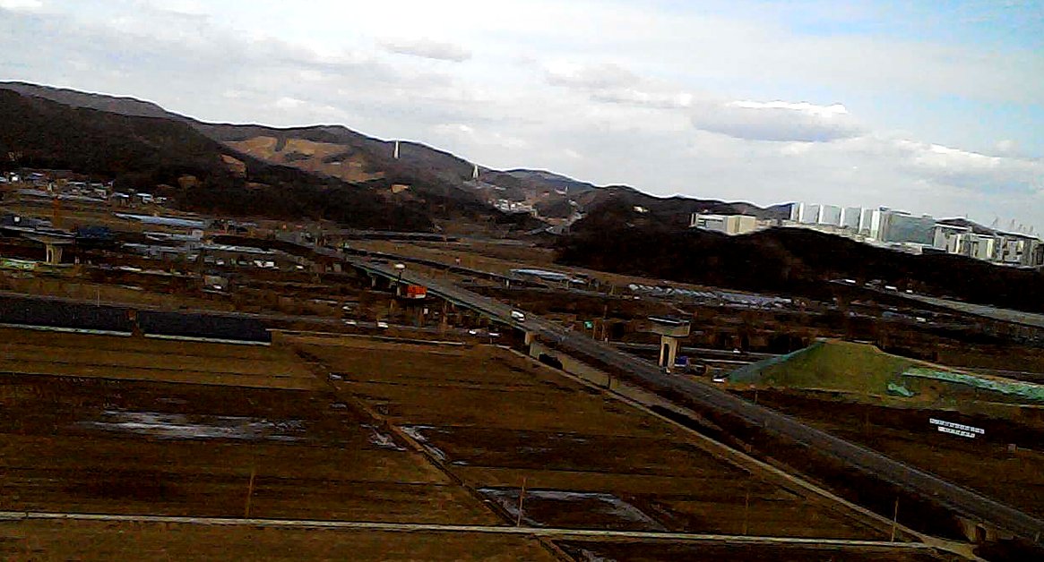

Slide 8
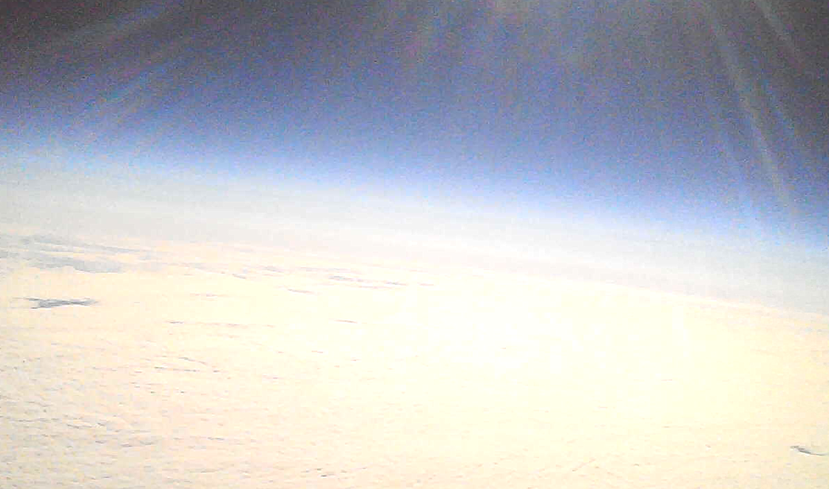

Slide 9
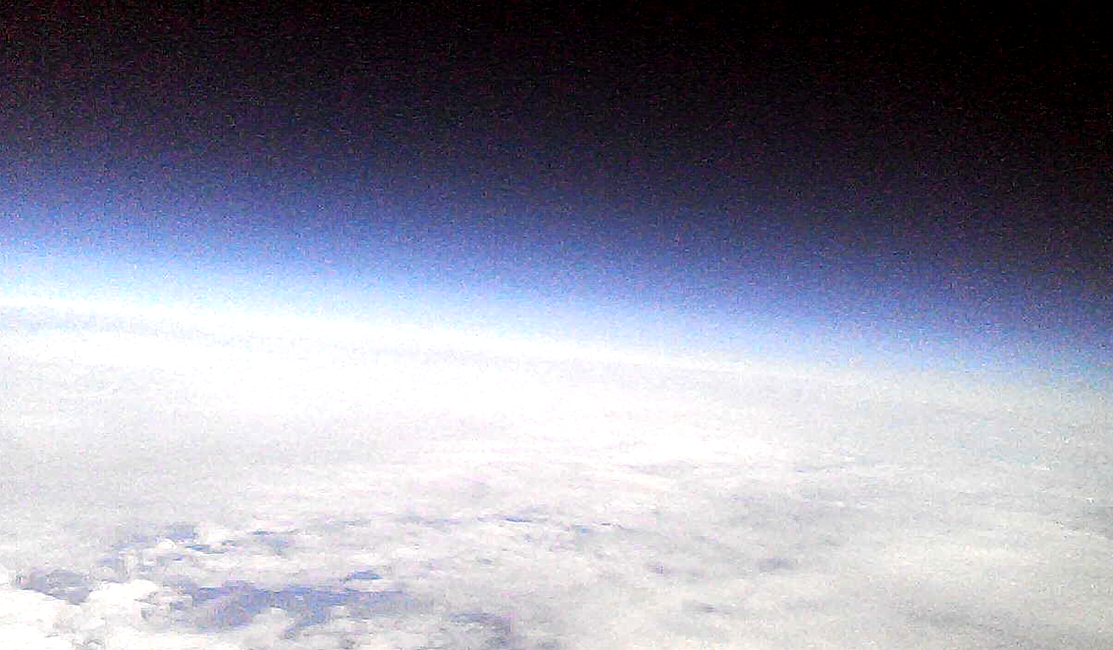

Slide 10
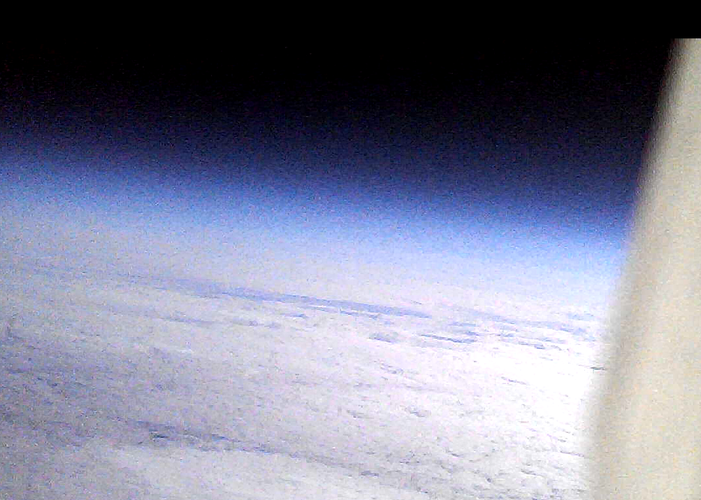

Slide 11
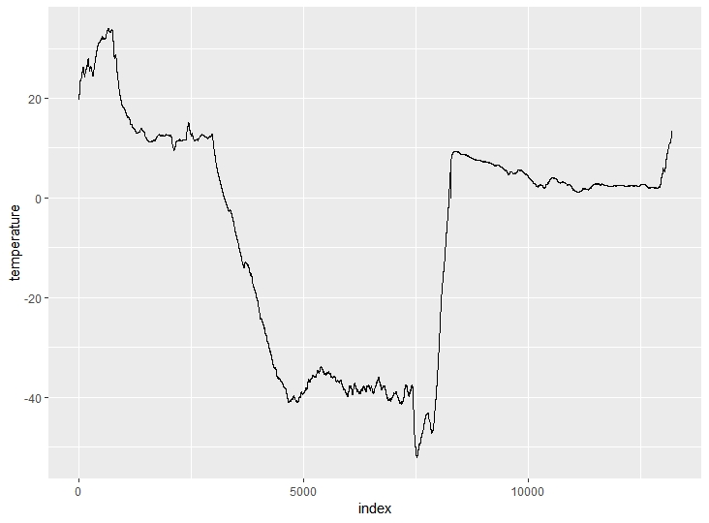
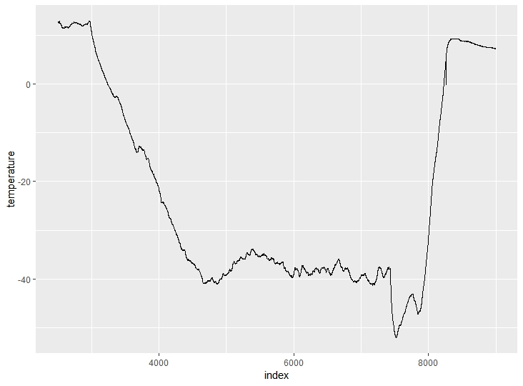
a)
b)
Fig 3. Plots of temperature record data
(a) Record of full data including data on non-flight time. (b) Plot of data on flight time extracted from raw data, and the high lighted part is the burst point, whose temperature is (-33︒C), and estimated altitude is 36km.

Slide 12
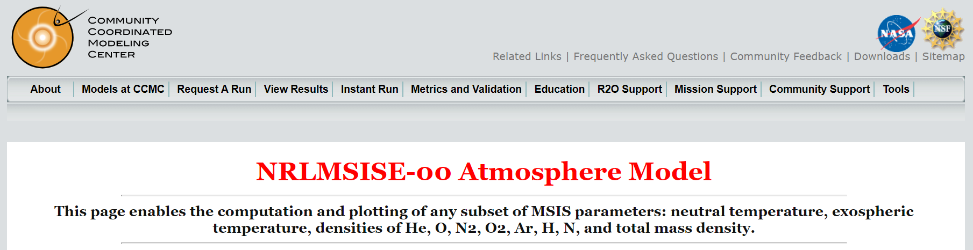
Fig 1. NRLMSISE-00 Atmosphere model
This atmospheric data table and tools for analysis of it produce various statistical results. It can be used via https://ccmc.gsfc.nasa.gov/modelweb/models/nrlmsise00.php.

Slide 13
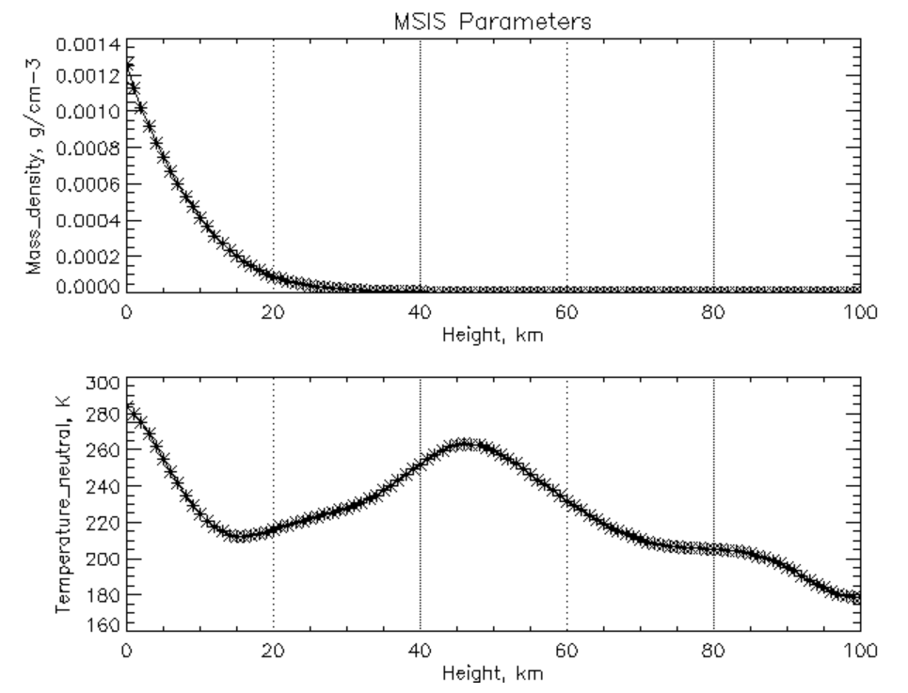
Fig 2. Expression of density and temperature by altitude from NRLMSISE-00
In the range of 0 to 100 km, the (a) density(g/cm-3) and (b) temperature(Kelvin, K) by height(km).

Slide 14
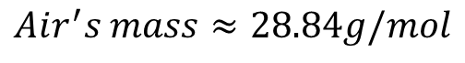
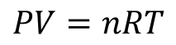
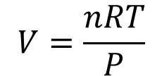
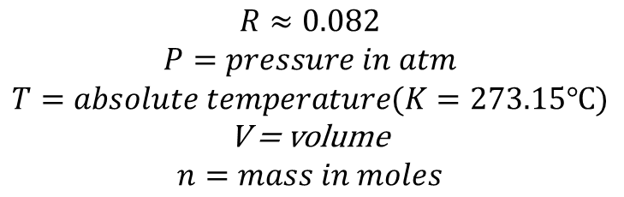
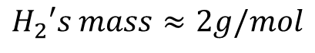
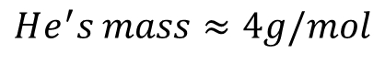
Calculate volume, in liter, for 1 mole by altitude
$$V=\frac{nRT}{P}$$
$$Air^{′}s mass≈28.84g/mol$$
$$PV=nRT$$
$$He^{′}s mass≈4g/mol$$
$$H_{2}′s mass≈2g/mol$$
$$R≈0.082$$
$$P=pressure in atm$$
$$T=absolute temperature(K=273.15℃)$$
V = volume
$$n=mass in moles$$
Using ideal gas equation to calculate density

Slide 15
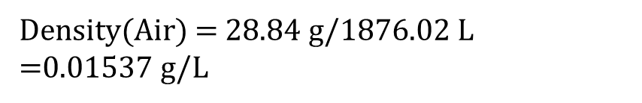

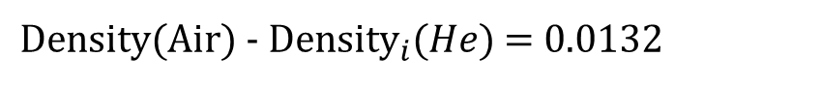
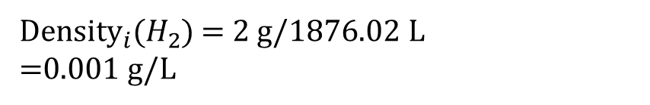
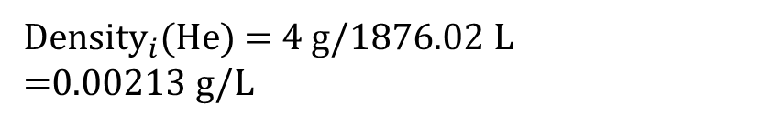
Altitude = 31km (Expected height)
$$V=\frac{1∗0.082∗227.65}{0.00995048}=1876.02$$
Density(Air) = 28.84 g/$\text{1}\text{876.02} \text{L}$
=0.01537 g/L
${\text{Density}}_{i}$(He) = 4 g/$\text{1}\text{876.02} \text{L}$
=0.00213 g/L
${\text{Density}}_{i}$($H_{2}$) = 2 g/$\text{1}\text{876.02} \text{L}$
=0.001 g/L
${\text{Density}\text{(}\text{Air}\text{) - }\text{Density}}_{i}$($He$) = 0.0132

Slide 16
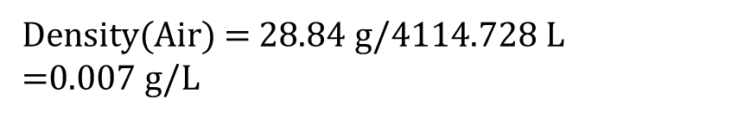

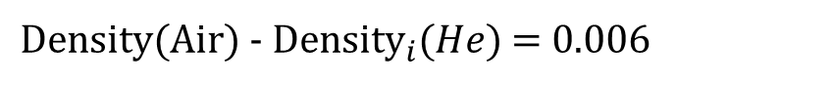
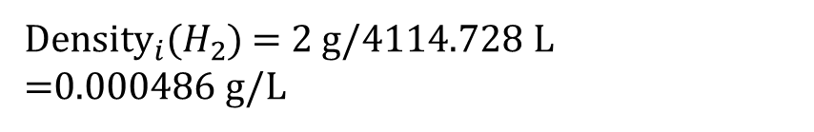
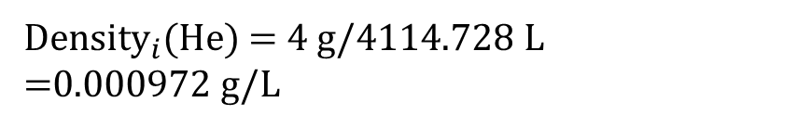
Altitude = 36km (Observed height)
$$V=\frac{1∗0.082∗239.850}{0.00477983}=4114.728$$
Density(Air) = 28.84 g/$\text{4}\text{114.728} \text{L}$
=0.007 g/L
${\text{Density}}_{i}$(He) = 4 g/$\text{4}\text{114.728} \text{L}$
=0.000972 g/L
${\text{Density}}_{i}$($H_{2}$) = 2 g/$\text{4}\text{114.728} \text{L}$
=0.000486 g/L
${\text{Density}\text{(}\text{Air}\text{) - }\text{Density}}_{i}$($He$) = 0.006

Slide 17
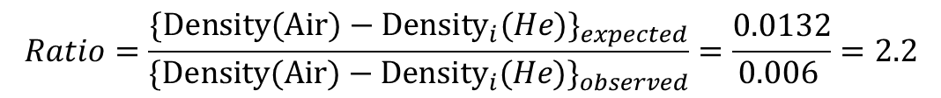
$$Ratio=\frac{{{\text{\{}\text{Density}\text{(}\text{Air}\text{) − }\text{Density}}_{i}\text{(}He\text{)}\text{\}}}_{expected}}{{{\text{\{}\text{Density}\text{(}\text{Air}\text{) − }\text{Density}}_{i}\text{(}He\text{)}\text{\}}}_{observed}}=\frac{0.0132}{0.006 }=2.2$$
If both of balloons in two cases(multi layered and single layered) have the same volume (Liter, L) of lift up gas, this result of calculation means that multilayered balloon can take surface tension 2.2 times greater than single layered one.

Slide 18
Thank you
Min Hyeong Lee
minhyeong1022@gmail.com

